Slide 1




cdc.dev
A Top-Notch tech conference right in the middle of paradise!
@caribbeandevconf

Slide 2






What is a message queue and why would I use one?
Clemens Vasters
Microsoft Corporation
Chief Messenger
@clemensv
https://github.com/clemensv/messaging

Slide 3
Messengers

Slide 4
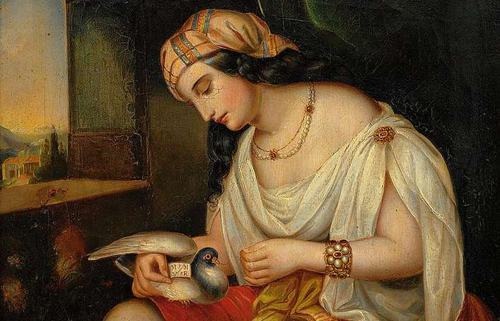

Slide 5
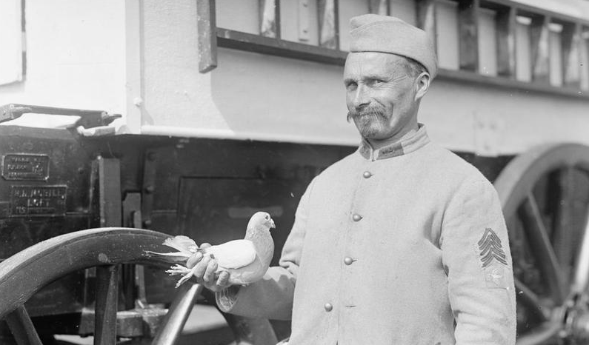

Slide 6
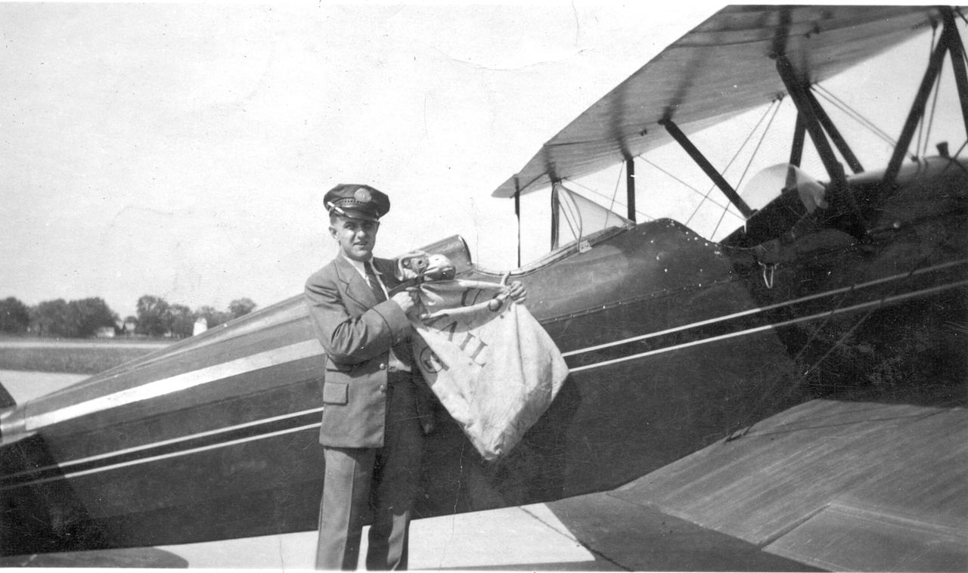

Slide 7
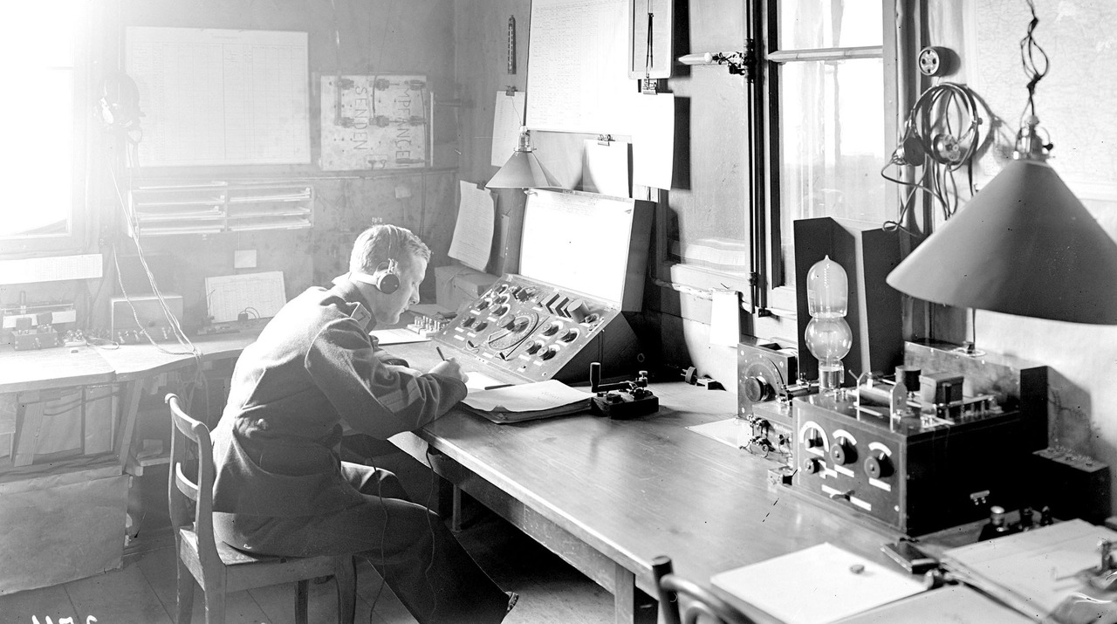

Slide 8
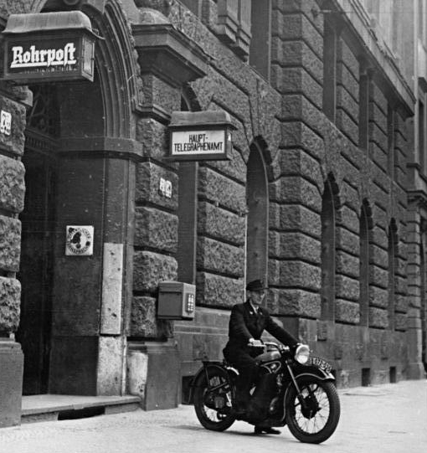

Slide 9
Queues

Slide 10

https://flic.kr/p/AyAMQA

Slide 11
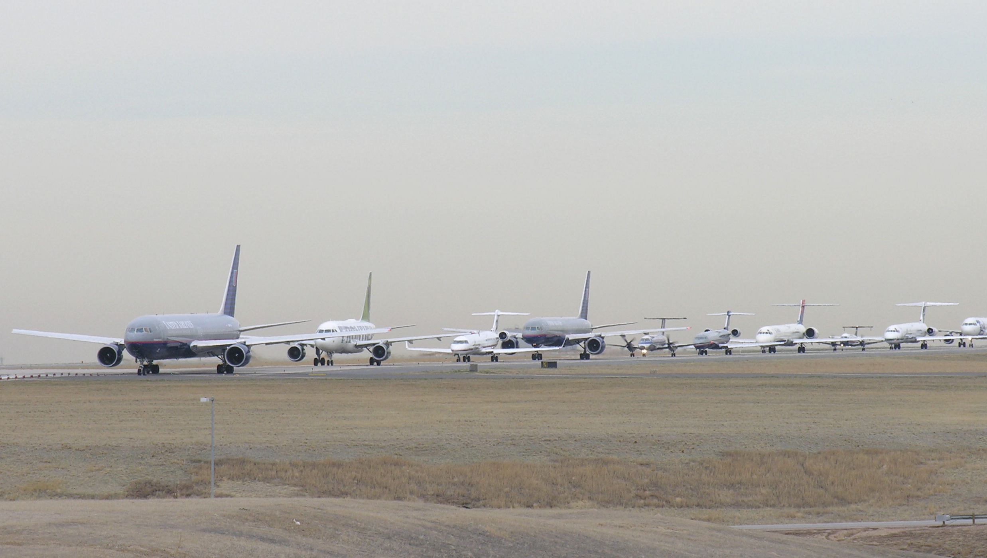
https://flic.kr/p/bXhNqK

Slide 12
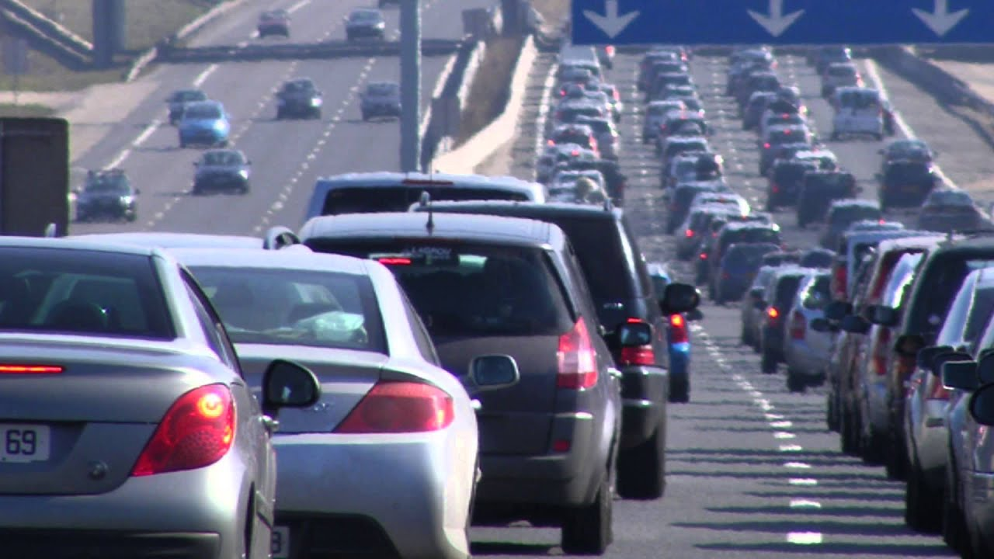

Slide 13
Agenda
What is a queue?
What is a message queue?
What are the common features?
Examples

Slide 14
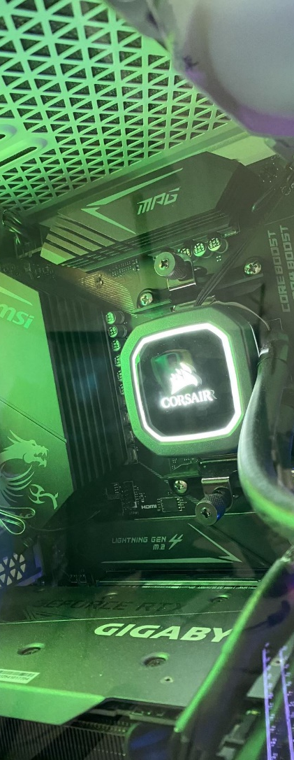
Function Calls
Local function calls translate to direct commands executed on (a core on) the CPU
add(5,4); int add(int a, int b) { return a + b; }
mov rcx, 5 mov rdx, 4 call add add: push rbp mov rbp, rsp mov rax, rcx add rax, rdx mov rsp, rbp pop rbp ret

Slide 15
Processes and Threads
Many processes/threads need to share few cores. Programs need to get in line.
OS Scheduler takes a waiting program (-thread) from the queue, maps it state onto the core, and has it execute for some predetermined time or until any I/O (including main memory access) is required.
mov rcx, 5 mov rdx, 4 call add add: push rbp mov rbp, rsp mov rax, rcx add rax, rdx mov rsp, rbp pop rbp ret
Job Queue
Ready Queue
I/O Queue
I/O

Slide 16
Thread Pools
Threads are expensive to create so it's more efficient to share them
OS Scheduler takes a waiting program (-thread) from the queue, maps it state onto the core, and has it execute for some predetermined time or until any I/O (including main memory access) is required.
add(5,4); add(1,9); add(6,5);
Pool Thread
Work Queue
Job Queue
Ready Queue
I/O Queue
I/O

Slide 17
Remote Function Calls
Remote Function calls translate to messages (requests and responses) transmitted over a network transport
add(5,4);
Proxy
Request add a=5 b=4
Listener & Dispatcher
int add(int a, int b) { return a + b; }
add: push rbp mov rbp, rsp mov rax, rcx add rax, rdx mov rsp, rbp pop rbp ret
Response add result=9
Job Queue
Ready Queue
I/O Queue
I/O

Slide 18
Listener & Dispatcher?
Network Endpoint
Connection Accept Queue
192.168.1.114
Pool Thread
Connection
Socket
TCP Input Buffer Queue
HTTP Request Queue
Dispatch Logic "/add" ➔ add()
Client
Listener
TCP Output Transfer Queue
int add(int a, int b) { return a + b; }
The client network proxy mirrors of all of this.

Slide 19
A single "synchronous" API call runs through dozens of queues because operating systems and runtimes use them to enable resource sharing and to scale better …
Funny, huh?

Slide 20
What is a queue?
read (consumption) removes
The queue is one of most fundamental and most important data structures in computing.
top
older
Sequence of records, commonly ordered by moment of arrival.
Write/add at the bottom, read/consume from the top.
Consumed records are removed.
Length of the queue can always be read.
ordered sequence
time
length
bottom
newer
write adds

Slide 21
Variation: Priority queue
read (consumption) removes
A priority queue first orders by a priority indicator attached to the records and then by time.
top
older
Higher priorities rush to the top
1
3
2
2
2
1
1
ordered sequence
time
length
bottom
newer
write adds

Slide 22
Variation: Multiplex queue
read (consumption) removes
A multiplex queue maintains arrival order but allows for labeled groups of records that can be read independently.
?a
top
older
c
c
Might avoid "head of line blocking"
Reader will indicate which records it wants to read
Readers get the oldest available message that matches their filter criterion
Priority queues are a special multiplex queue
1
b
b
a
time
length
ordered sequence
a
a
bottom
newer
write adds

Slide 23

What is a message queue?
Accepts, stores, and makes messages available for consumption.
Queue individually manages the lifecycle of each message
Accepted, available, acquired, archived/deleted, rejected
Messages are exclusively acquired by one consumer.
The queue length can be queried.
Seq no 741
Producer
Seq no 744
Seq no 743
Seq no 742
Seq no 741
Seq no 740
Consumer
available
available
available
acquired
deleted
transfer
transfer

Slide 24
For anyone thinking "Apache Kafka" here …
Kafka is not a message queue.

Slide 25
What is a message?
Message Broker
A message is an envelope annotated with metadata around a data structure to be moved between apps or services.
Data is for the apps
Metadata is for the messaging infrastructure and dispatch code.
To, Subject, Content-Type, CorrelationId, …
Message
Business App
to: /test subject: Info content-type: application/json dataschema:
Meta- data
Encoded Data Structure
{ “name” : “Emma”, “lastname” : “Example”, “city” : “Roma”, “country” : “Italy”, }
Body

Slide 26
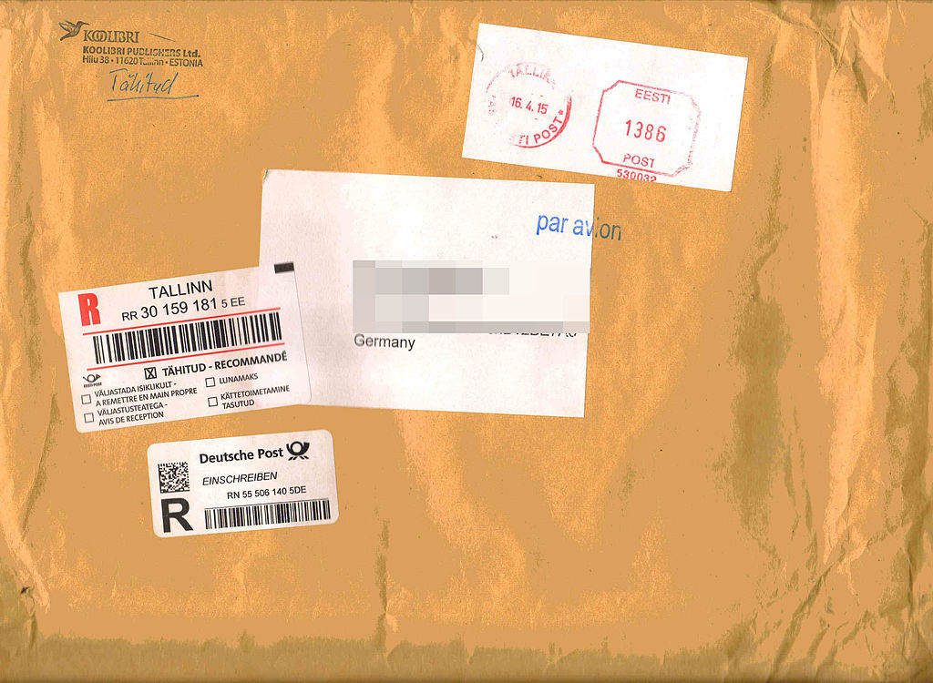

Slide 27
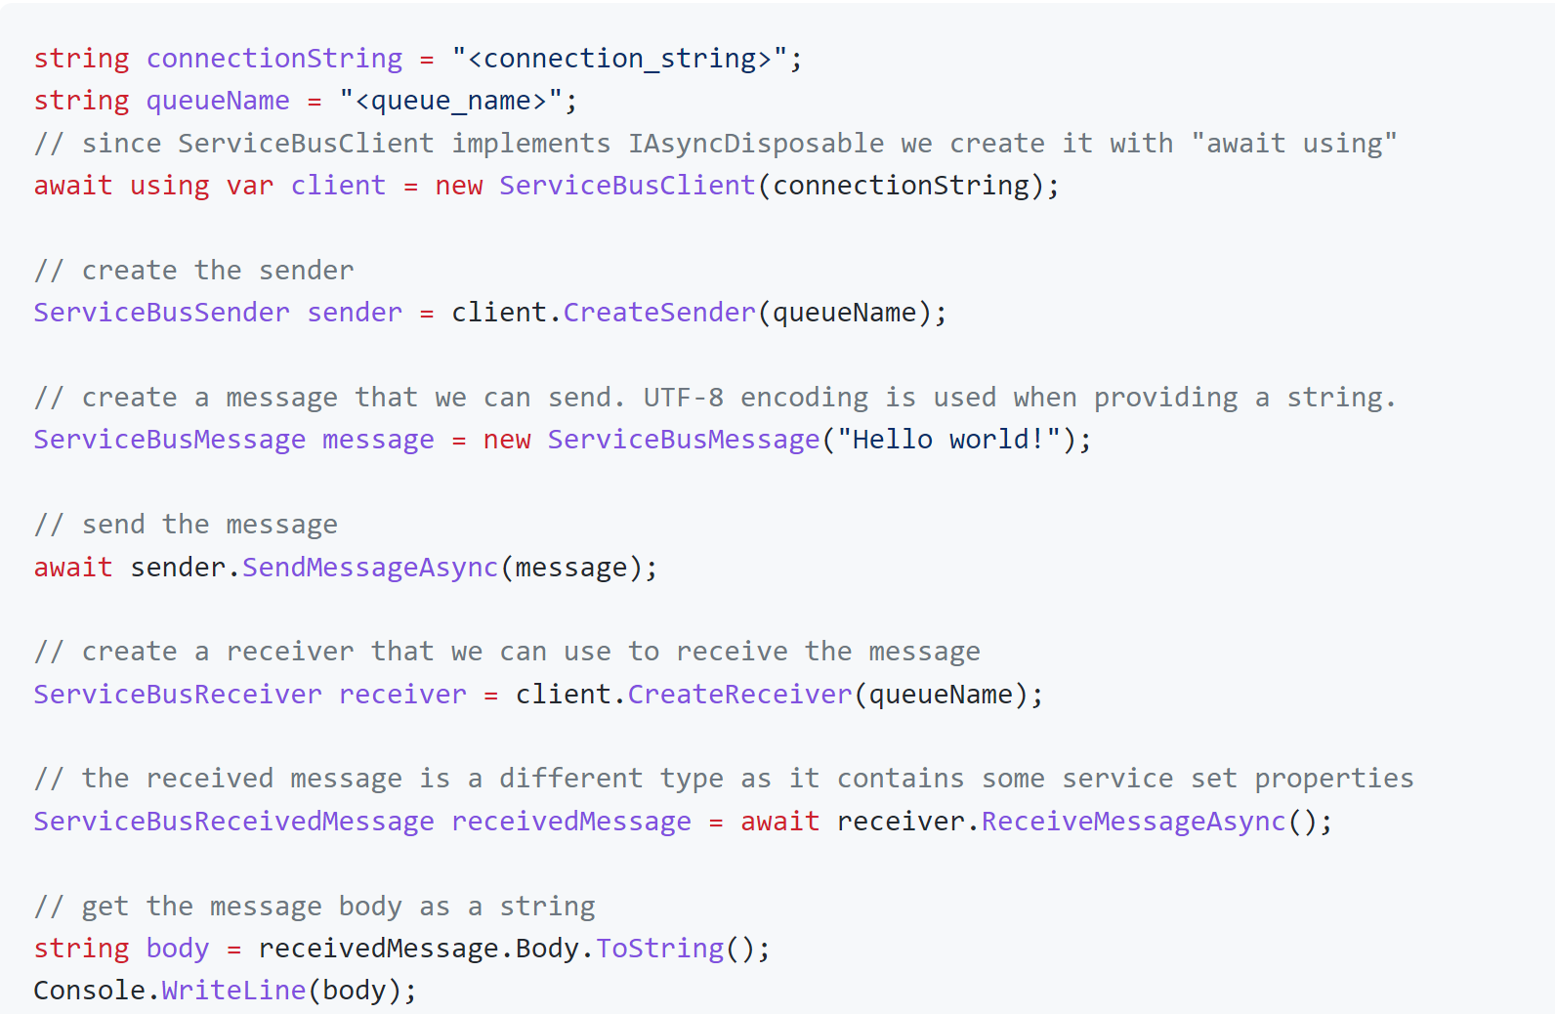
Send & Receive
Messages are up to the application to design. You can use any encoding (like JSON) for payloads.

Slide 28
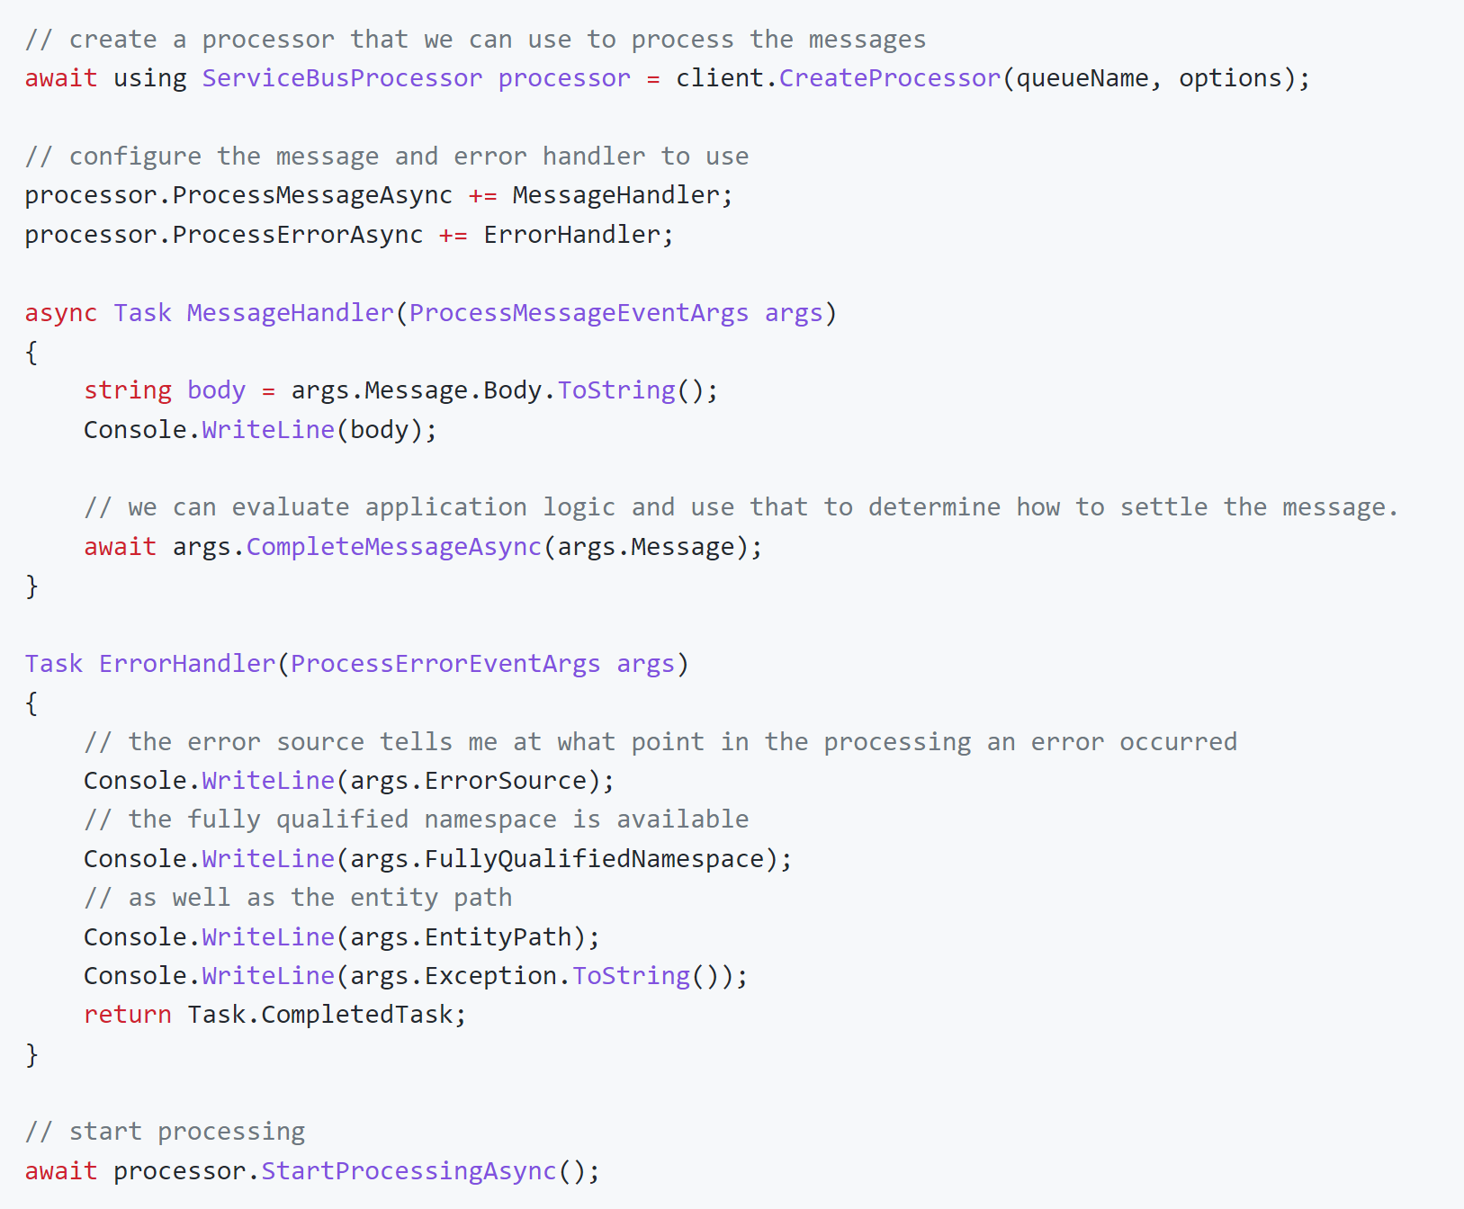
Reactive processing loop
Modern programming models have a standard receive loop built for you that you extend with handlers.

Slide 29
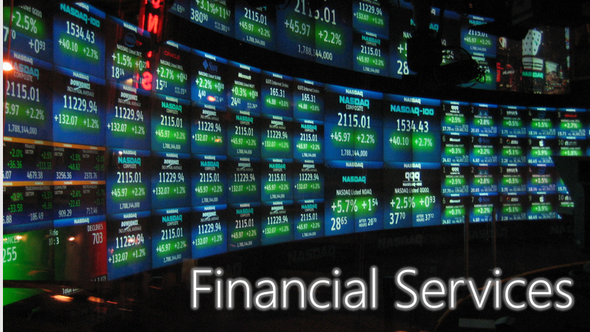
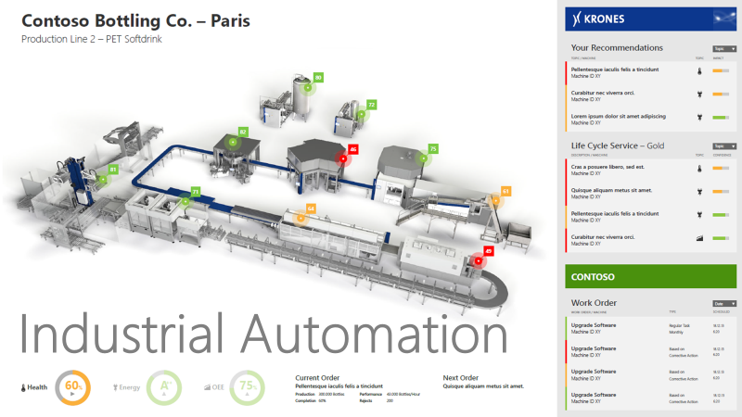
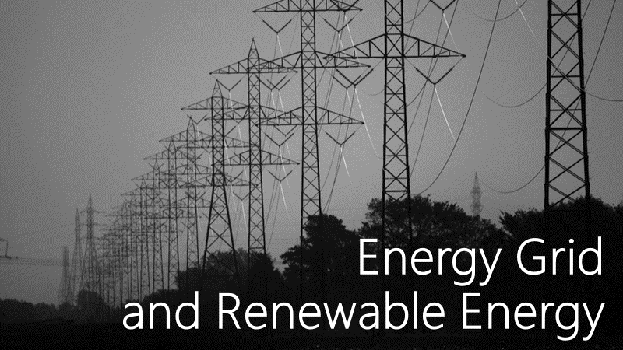
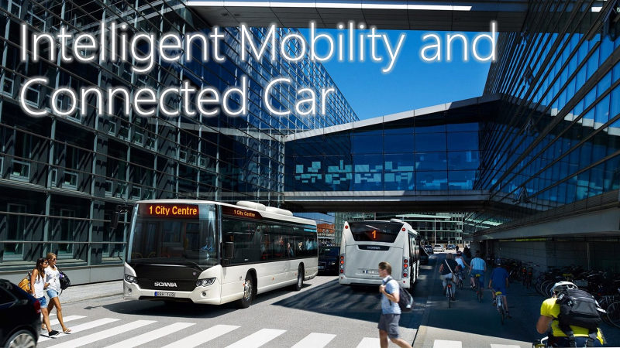

Slide 30


Queues are safe network bridges
Some queue brokers can be attached to one or more virtual networks and the public IP address space concurrently and act as safe "Layer 7" (app-level) routers.
Customer Virtual Network: 10.1.0.0/16
Subnet 1: 10.1.1.0/24
Public Network
Service Bus Namespace
Customer NAT
Private Endpoint 10.1.1.42
VM 10.1.1.28
Client 192.168.1.2
Customer Virtual Network: 10.2.0.0/16
Subnet 1: 10.2.1.0/24
Private Endpoint 10.2.1.23
VM 10.2.1.56

Slide 31



Competing Consumers
Observing the queue length trends allows spinning up further resources as needed to handle exceptional load.
Web
Business Process
Web
Business Process
Web
Business Data
Web
Competing Consumers Pattern Messages get distributed amongst competing receivers. Exclusive ownership of message.

Slide 32
Load Leveling
Offline / Batch Pattern Work jobs can be queued up and processed periodically. Processor may be offline.
Adding a message queue allows the business process to handle transactions at optimal capacity use and without getting overwhelmed
Spiky loads are buffered by the queue until the processor can handle them
Web
Web
Business Process
Web
Business Data
Web
Load Leveling Pattern Uneven transaction load distribution is leveled out; processor proceeds at robust pace

Slide 33
Azure Service Bus Queues (I)
There can be up to 5000 concurrently competing consumers per entity.
First come, first served.
Send: Add sequence number & server timestamp, write/flush to log, then report as accepted
Sequential log, ordered by sequence number (order of arrival)
Seq no 741
Acquired messages are locked exclusively to the acquirer (consumer) until they are settled or the lock expires*
Consumer
Producer
Seq no 744
Seq no 743
Seq no 742
Seq no 741
Seq no 740
transfer
Consumer tells the broker the state of the message. accepted: Accepted and handled. Can be removed, must not be redelivered. released: Not handled. Should be redelivered.
rejected: Not handled. Considered defective. Must not be redelivered.
available
available
available
acquired
deleted
accept
Consumer
Max message size: Std: Up to 1MB Prm: Up to 100 MB
Max queue size: Up to 80GB
Oldest available message is the next to be acquired and delivered. In Premium, using JMS, consumers can skip to the first available message that fits a certain criterion (message selector) without head-of-line blocking.
transfer
Seq no 740
* locks always have a timeout and instantly expire when the connection breaks. (As of 3/22, might change ;)

Slide 34
Azure Service Bus Queues (II)
Every queue and topic subscription has its own dead-letter subqueue: myqueue/$deadletterqueue
All messages that cannot be delivered (released more often than permitted) or have been rejected and optionally those that have expired and put into the dead-letter queue and remain there.
The reason for why and from where the message has been moved is remarked in the DeadLetterReason, DeadLetterErrorDescription, and DeadLetterSource properties.
The deadletter queue is otherwise a normal queue and can be used with the normal receiver clients.
Dead-letter Queue
Messages can have a defined time-to-live after which they are automatically removed from the queue. Those messages may be optionally dead-lettered.
Seq no 521
Seq no 671
available
available
Producer
Seq no 744
Seq no 743
Seq no 742
Seq no 741
Seq no 740
scheduled
deferred
available
acquired
deleted
Scheduled messages have been accepted and stored in the queue log, but they are made available for delivery only after ScheduledTimeUtc.
Scheduled messages can be canceled using the sequence number returned by the scheduling API.
Deferred messages have been delivered to a consumer at least once and the consumer has decided to set them aside instead of settling them.
Deferred messages remain in the log but are not eligible for delivery until they are restored into the available state.

Slide 35
Azure Service Bus Queues – Sessions
Sessions are unlimited, unbounded, ordered sequences of messages that are all labeled with the same SessionId. Using sessions requires a session-enabled queue or topic subscription.
Consumers acquire exclusive locks on the entire session and all messages belonging to it.
An active session behaves like an independent queue, without messages from other sessions blocking progress (no "head of line blocking")
Seq no 740
deleted
Producer
Seq no 743
Seq no 741
Consumer
SessionId "123"
123
available
acquired
The owning consumer of a session has read/write access to the session state that the broker optionally maintains. Session state can hold data up to the max size of a message permitted for the queue.
When a new consumer acquires the session, it can therefore access all info left by a prior consumer related to processing the session.
Built for long-running workflow processes.
Seq no 744
Seq no 742
Consumer
SessionId "563"
563
available
available
A single queue can maintain hundreds of thousands of sessions and thus logical sub-queues.

Slide 36
Azure Service Bus Queues – Transactions
A transactional operation can send messages to any number of output queues or topics as a result of the transactional work. Sends are held until the transaction succeeds.
Service Bus transactions are a reliability anchor for performing high-value work in the cloud. Settling an input message of a job and sending resulting outputs of the job jointly suceeds or fails (with retry in the latter case).
Transaction Scope
Seq no 741
Seq no 8152
Producer
Seq no 744
Seq no 743
Seq no 742
Seq no 741
Consumer
acquired
scheduled
deferred
available
acquired
Seq no 9211
Transactions form around a "lead queue" from which the input message for the transactional work was acquired. Only one receiving queue can be enlisted in a transaction. Sessions are supported.
acquired
All settlement operations on the lead source queue are transactional: accepting (complete), releasing, rejecting (deadletter), deferral, session state ops.

Slide 37
Azure Service Bus Topics
For consumers, subscription queues have all features of queues, including a dead-letter queue. They can also support sessions.
Actions can add, remove, and edit all application message properties and system properties like TimeToLive or SessionId.
One subscription can have up to 2000 (!) rules. Each filter match yields a copy of the tested message.
Correlation filters match properties against values ("equals").
SQL filters allow WHERE-condition-style SQL expressions against the app and platform message properties. sys.To LIKE 'region/DE/shops/%' AND subject='catalogUpdate'
Filter Action
Filter Action
Producer
Topic
Service Bus Topics are named multicast distribution points for messages.
Subscriptions are durable queues bound to topics through a collection of selection rules.
The $default rule selects all messages into the sub's queue
Filter
$default
JMS clients can use shared, unshared, durable and volatile subscriptions, with JMS-compliant SQL message selectors.
true

Slide 38

Push-style distribution of discrete events to serverless workloads or other messaging infrastructures
Discrete Event Router
Azure Event Grid, AWS Event Bridge, Knative Eventing
Queue Pub/Sub Broker
Pull-style, queue-based transfer of jobs and control via message queues and topics
Azure Service Bus, AWS SQS/SNS, Google PubSub, Apache ActiveMQ, RabbitMQ, IBM MQ
Event Stream Engine
Partitioned, high-volume, tape-drive-style sequential recording and unlimited, pull-style re-reads of event streams.
Azure Event Hubs, AWS Kinesis, Apache Kafka, Apache Pulsar, CNCF Pravega
Event Stream Aggregator
Stateful processing of event streams yielding event streams and discrete events as continuous output
Azure Stream Analytics, AWS Kinesis Analytics,
Apache Samza, Apache Flink, etc.

Slide 39
Event Streaming is not "modern" and Queues are not "traditional"
Both are patterns of state-of-the art messaging infrastructures.

Slide 40
Modern apps use eventing and queue-based messaging
“Core” functions of services require direct, point-to-point, RPC or queue-based interaction:
Imperative: Commands, Requests
Extensions react to events or insights derived from event streams emitted by services.
Might turn to the emitting service to ask for details or perform actions.
Messaging
Direct Interaction
Extension by subscription
Eventing

Slide 41
Thank You!

Slide 42
https://github.com/clemensv/messaging

Slide 43
Creative Commons Attributions
https://commons.wikimedia.org/wiki/File:Junge_Frau_mit_Taubenpost.jpg
https://commons.wikimedia.org/wiki/File:The_Royal_Engineers_Signals_Service_on_the_Western_Front,_1914-1918_Q8877.jpg
https://commons.wikimedia.org/wiki/File:Pony_ExpressAdvert.jpg
https://commons.wikimedia.org/wiki/File:Phidippides.jpg
https://commons.wikimedia.org/wiki/File:Bundesarchiv_Bild_183-S99696,_Berlin,_Haupttelegrafenamt,_Motorradbote.jpg?uselang=de
https://commons.wikimedia.org/wiki/File:Photographic_copy_of_retouched_photograph_%28circa_1918,_original_print_in_Archives,_Public_Affairs_Department,_Sears_Merchandise_Group,_Hoffman_Estates,_Illinois%29._Photographer_HABS_ILL,16-CHIG,110A-85.tif
https://commons.wikimedia.org/wiki/File:Airmail_1930s_Detroit_Smykowski.jpg
https://commons.wikimedia.org/wiki/File:Soldat_in_der_Empfangsstation_f%C3%BCr_drahtlose_Telegraphie_-_CH-BAR_-_3239488.tif
https://commons.wikimedia.org/wiki/File:Registered_mail_from_Estonia_to_Germany.jpg?uselang=de
https://commons.wikimedia.org/wiki/File:HollerithMachine.CHM.jpg
http://bitsavers.trailing-edge.com/pdf/ibm/360/os/qtam/C28-6553-2_Telecommunications_Preliminary_Specifications_Dec65.pdf
https://commons.wikimedia.org/wiki/File:Gie%C5%82da_na_Wall_Street.JPG

